Slide 1
Advanced Programming
Good practices
Samuel Styles - 05.08.2025

Slide 2

Board member of the SGA (Swiss game academy)
Gold member of the SGC (Swiss game center)
SStyles93 (Samuel Styles) (github.com)
Samuel Styles Blogposts – Blogposts about my studies (sstyles93.github.io)

Slide 3
Advanced Programming
Chapter I Attributes, Enums, Heritage, ScriptableObjects
Chapter II
Delegates
Chapter III
Coroutines, Gizmos, Raycast, Interface Segregation
Chapter IV
Delegates (again), Saving data, Singleton, Observer Pattern
+ S.O.L.I.D all along

Slide 4
Let’s start ! First we are going to install the project !

Slide 5
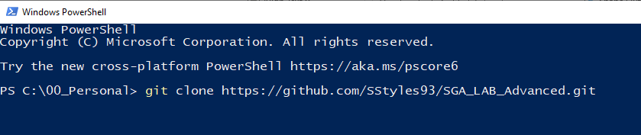
Project Instalation
Use:
git clone https://github.com/SStyles93/SGA_LAB_Advanced.git
In a terminal at the desired location.

Slide 6
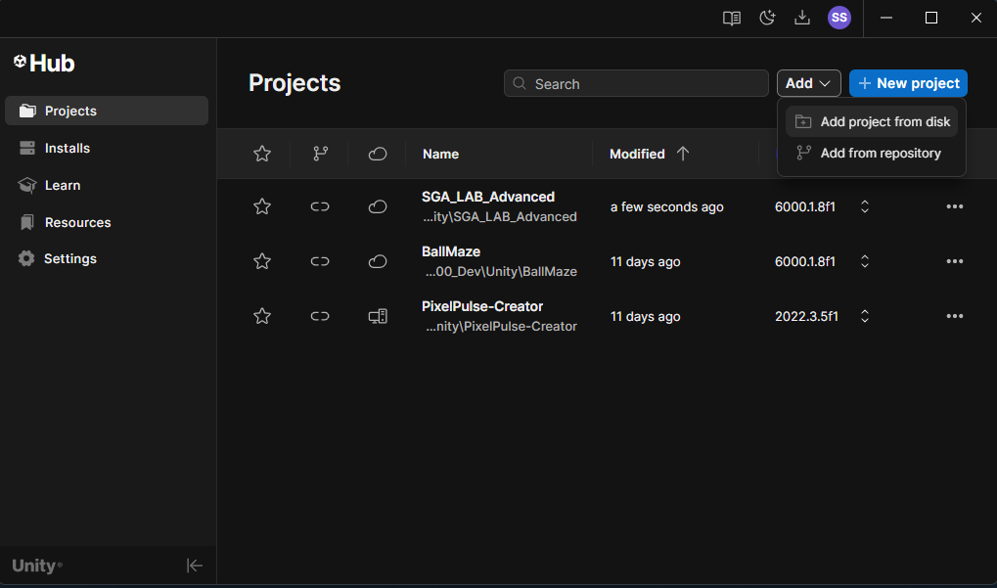
Project Instalation
Add the project from disk with the clone’s path

Slide 7
Project Instalation
Open the project with the Unity Hub
Install the Unity version 6000.1.8f1
If necessary

Slide 8
Chapter I
Attributes, ScriptableObjects, Enums and Heritage

Slide 9
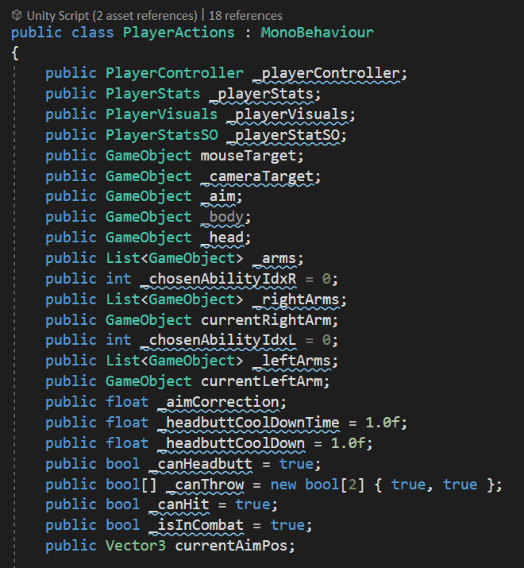
Chapter I - Unity attributes
If your code looks like this…the course is for you !

Slide 10
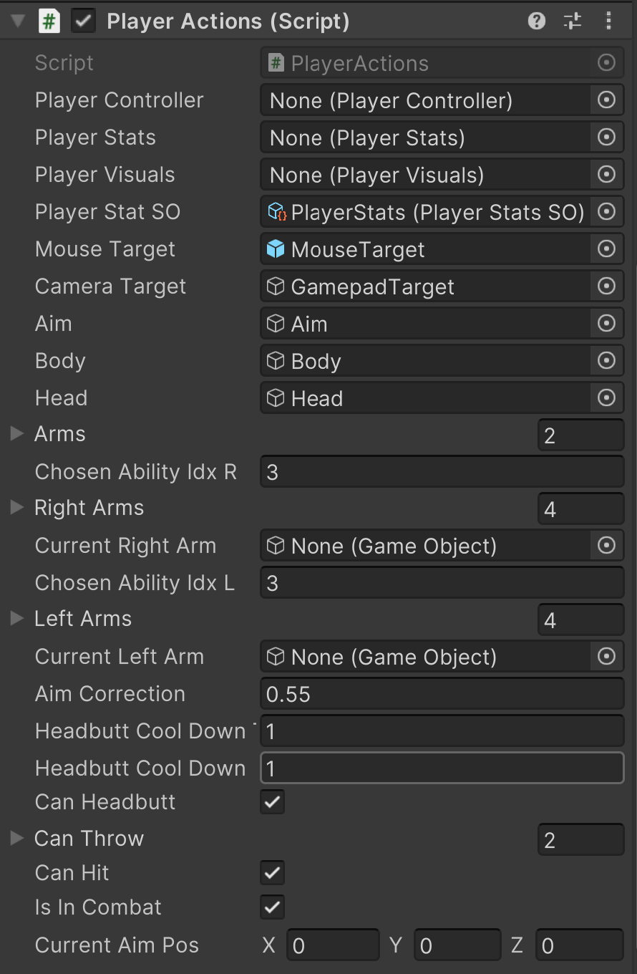
Chapter I - Unity attributes
This is what it looks like in the editor :(

Slide 11
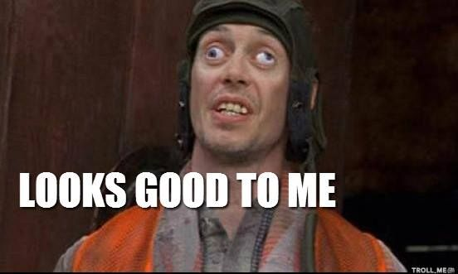
Chapter I - Unity attributes
Things you can use to make things more user friendly AND look better:
teebarjunk/Unity-Built-In-Attributes: A list of built in Unity Attributes. (github.com)
For nice Unity attributes

Slide 12
Chapter I - Unity attributes
Most usefull in my experience:
[Header("Stats")]
[Space(10)]
[Tooltip("The games score.")] public int score = 0;
For code
[SerializeField] private int score;
[System.Serializable]
[Range(0, 100)] public float speed = 2f;
[RequireComponent(typeof(RigidBody))]
For Visuals :
[GradientUsage(true)] public Gradient gradient;
[ColorUsage(true, true)] public Color color = Color.white;

Slide 13

Chapter I - SOLID
SOLID !

Slide 14
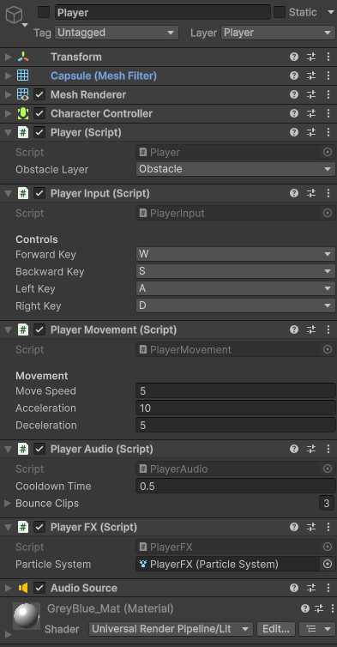
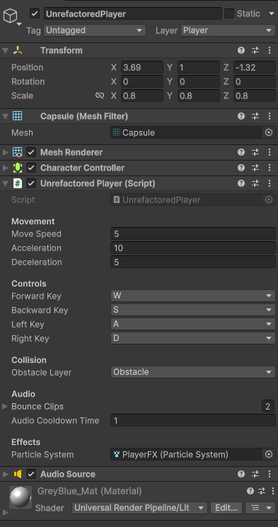
Chapter I – S.O.L.I.D
S = Single Responsibility Principle
“There should never be more than one reason for a class to change."
In other words: Every class should have only one responsibility.

Slide 15

Chapter I – S.O.L.I.D
Lets PRACTICE !

Slide 16
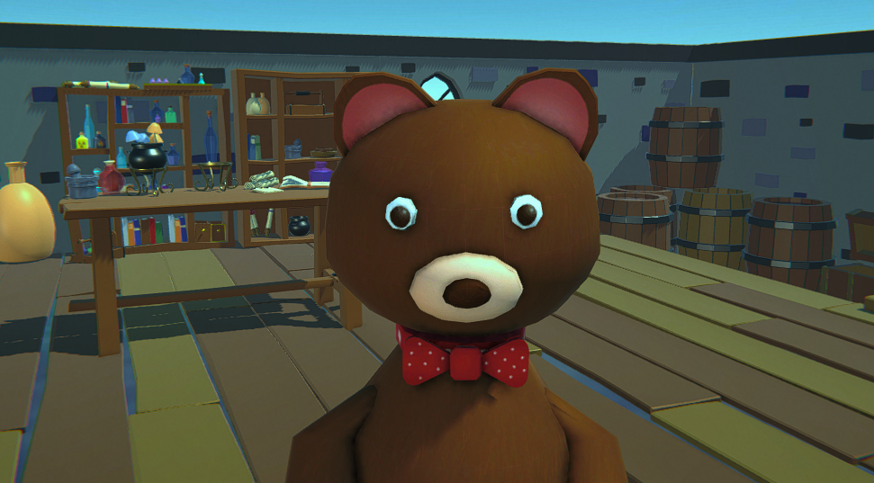
Chapter I - Unity attributes
Say Hi to
AlchemisTeddy

Slide 17
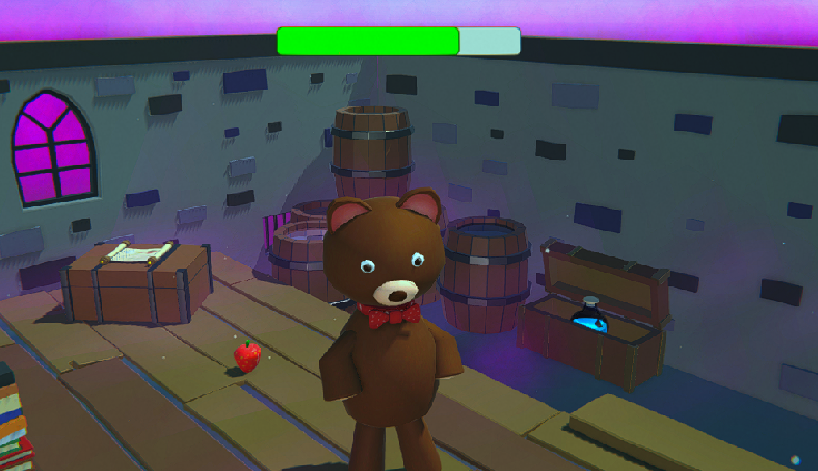
Chapter I - Unity attributes
AlchemisTeddy did a mistake and Poisonned himself.. Code to help him regain his life
Poisonned

Slide 18
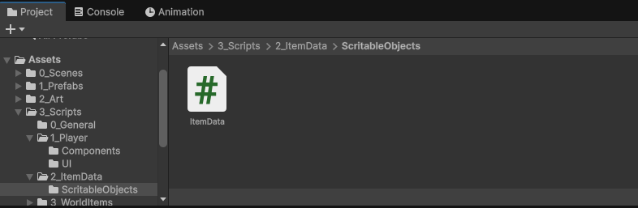
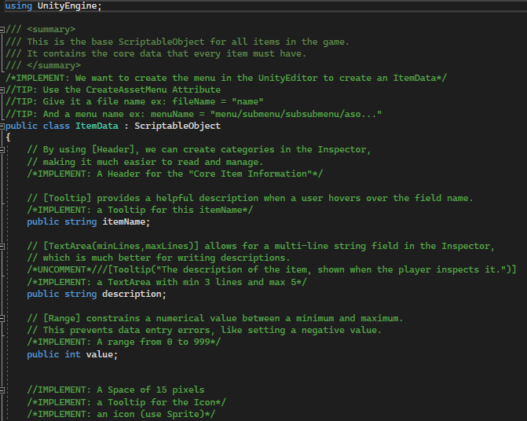
Chapter I - Unity attributes
PRACTICE Attributes & ScriptableObjects!
Go to the folder:
Assets/3_Scripts/2_ItemData/ScritableObjects
And open the « ItemData » script

Slide 19
Chapter I - Unity attributes
We are going to implement the code we need.
/*IMPLEMENT: …*/ - > has to be REPLACED by your code.
//TIP -> can be deleted but it is mainly for you.
/*UNCOMMENT*/ -> is to be uncommented.
/*REFACTOR*/
-> has to be improved

Slide 20

Chapter I – Scriptable Objs.
What is a scriptable object ?

Slide 21
Chapter I – Scriptable Objs.
It is a data container that can be used to READ and WRITE between scenes
Scene 00
Scene 02
Scene 01

Slide 22
Chapter I – Scriptable Objs.
It is a data container that can be used to READ and WRITE between scenes
Data stays modified even when exiting play mode ! (NO RESET!)
Editor
Editor
Play
HP = 100
HP -1
HP = 99

Slide 23
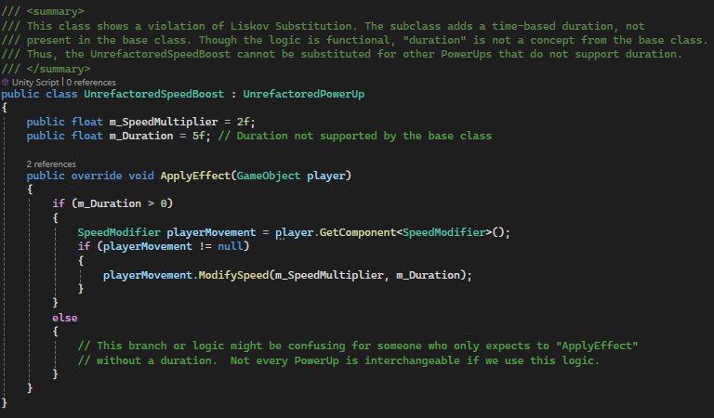
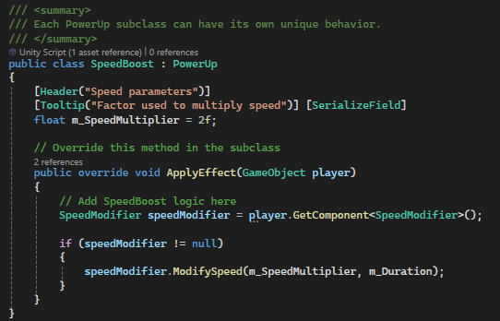
SOLID
Coding best practices
L = Liskov substitution Principle
“Functions that use pointers or references to base classes must be able to use objects of derived classes without knowing it."
In other words:
Super class objects should be substitutable by Sub class objects

Slide 24

Chapter I – Unity scripts
Now our variables look good and we coded our first Scriptable Object but what about the code ?

Slide 25
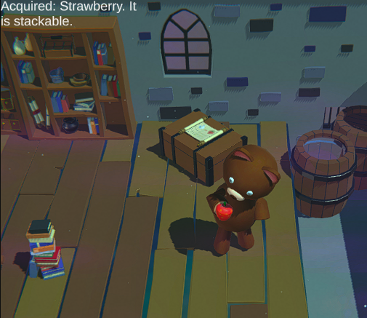
Chapter I – Unity scripts
Open PlayerInventoryManager Go to UpdateStatus() We are going to Use
Switches
and
Ternary operators

Slide 26
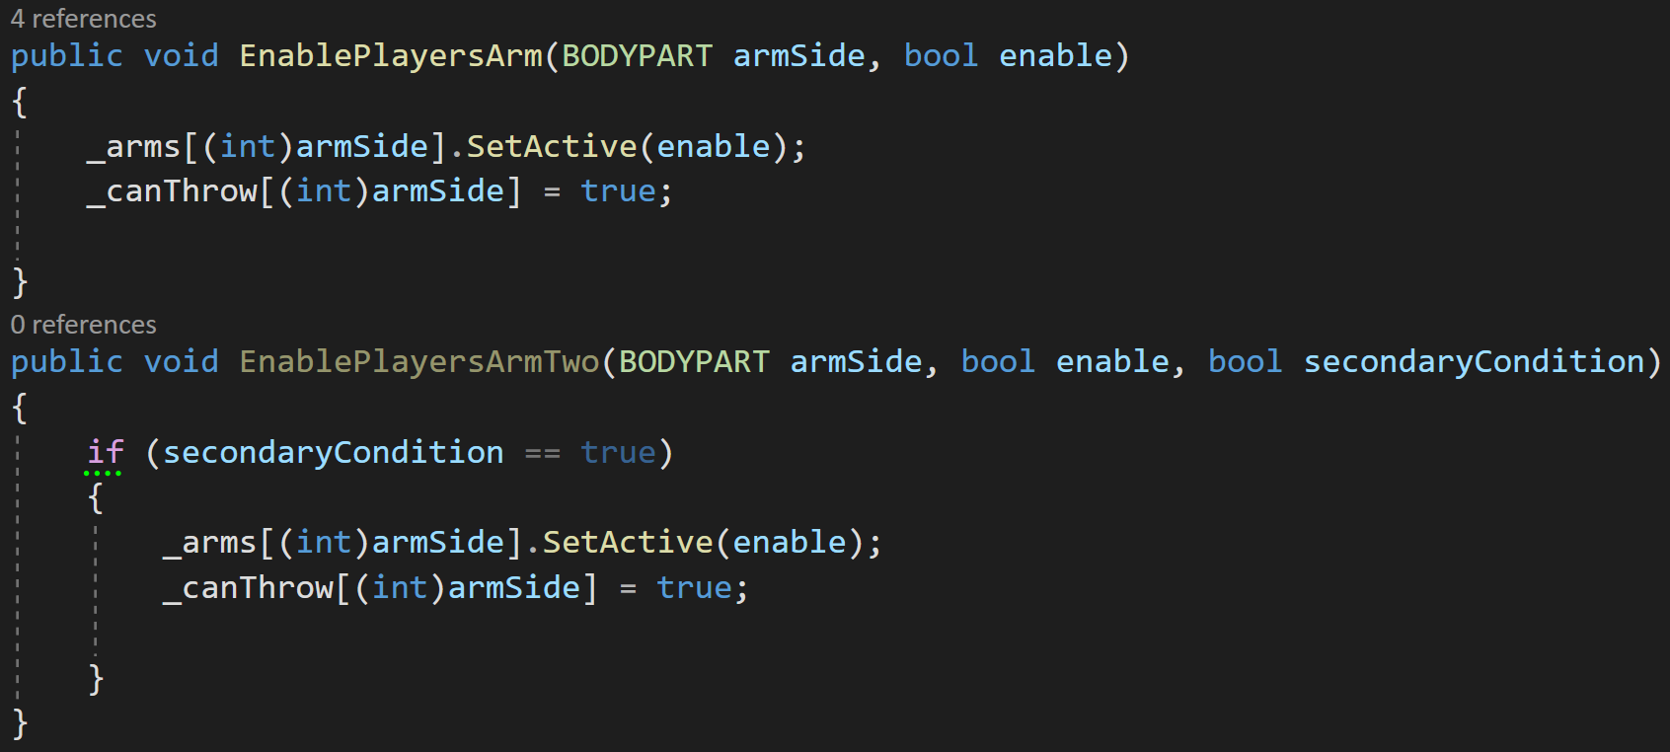
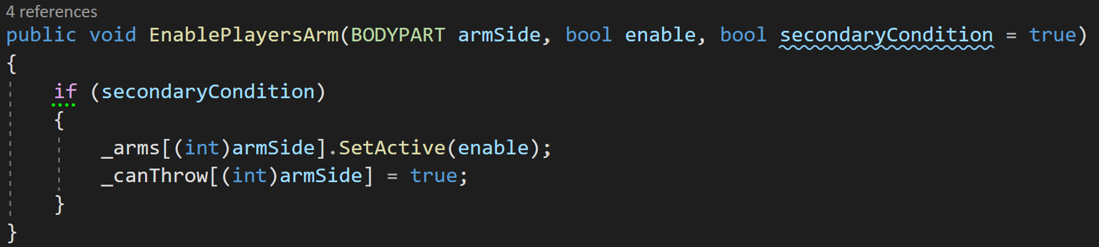
Chapter I – Unity scripts (TIP)
In C# we can use some useful features:
Instead of this:
Multiple variants of method
You can do this:
Optional parameters
public void Func(x,y, z = default Value)
Tip: Undefined number of parameters
Params collections - C# feature specifications | Microsoft Learn

Slide 27
Chapter II
Delegates (and Actions)

Slide 28
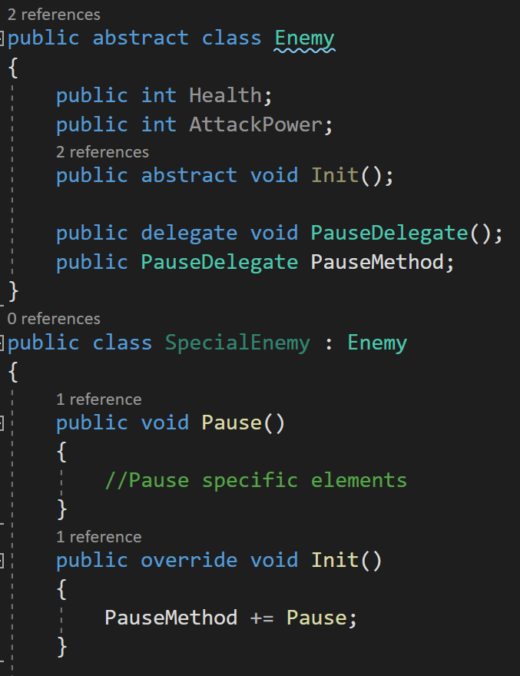
Chapter II - Delegates
What is a delegates !

Slide 29
Chapter II - Delegates
It is a method with a SIGNATURE:
ReturnType Name (Parameters)
Here
void PauseDelegate(No parameters);

Slide 30
Chapter II - Delegates
We then declare a delegate “PauseDelegate” called PauseMethod;
And with that we can subscribe methods
with THE SAME SIGNATURE
to the delegate method using: DelegateMethod += Method;

Slide 31
Chapter II - Delegates
This means that when the PauseMethod delegate is called
EVERY SUBSCRIBED method will be also called ! :D

Slide 32
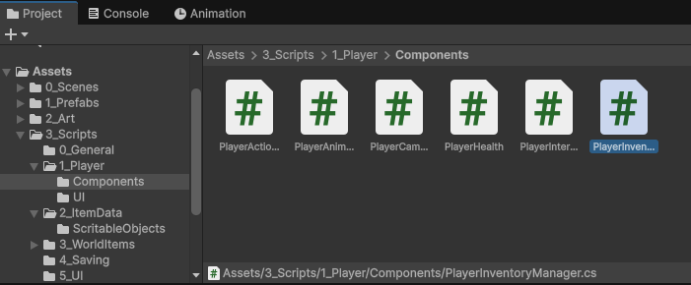
Chapter II - Delegates
PRACTICE Attributes & ScriptableObjects!
Go to the folder:
Assets/3_Scripts/1_Player/Components/
And open the «PlayerInventoryManager»

Slide 33
Chapter III
Coroutines, Gizmos, Raycast, Interfaces

Slide 34

Chapter III - Coroutines
A coroutine is a method that can suspend execution and resume at a later time.
IEnumerator MethodName()
{
Yield return … (to wait)
}
StartCoroutine(MethodName());
StopCoroutine(MethodName());

Slide 35
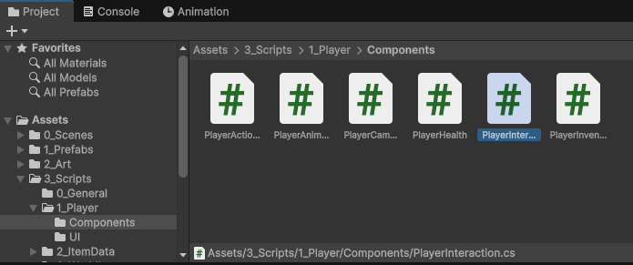
Chapter III - Coroutines
Time to PRACTICE ! Open
PlayerInteraction.cs

Slide 36

Chapter III - Raycast
Implement it !
Use:
and
RaycastHit hit;
if (Physics.Raycast(
from,
direction,
out hit,
max distance,
layerMask))

Slide 37
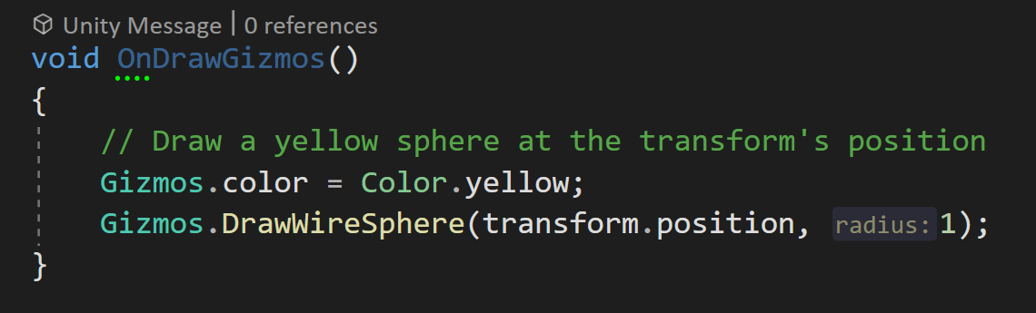
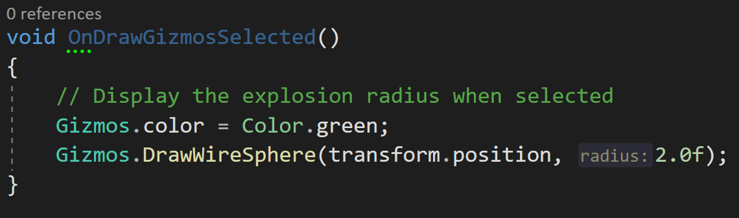
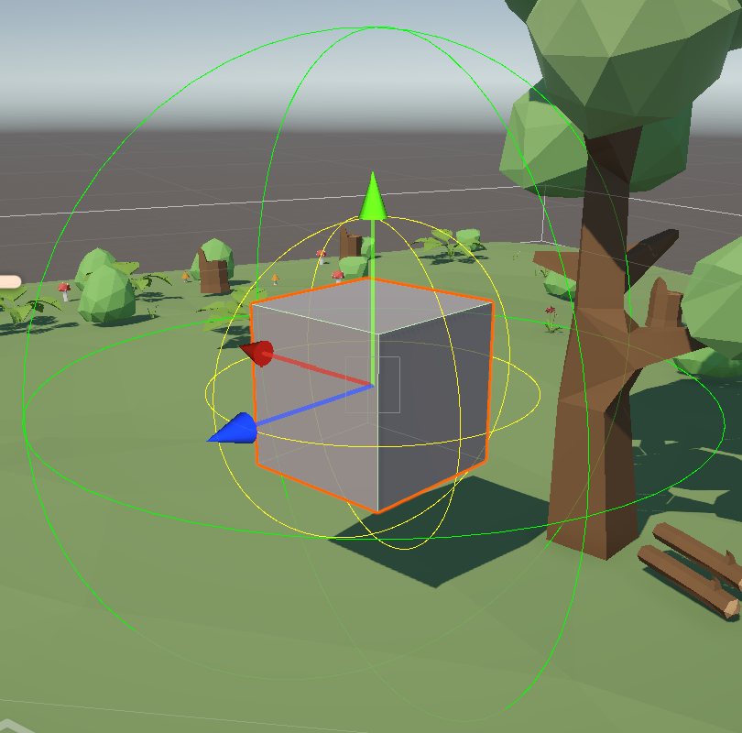
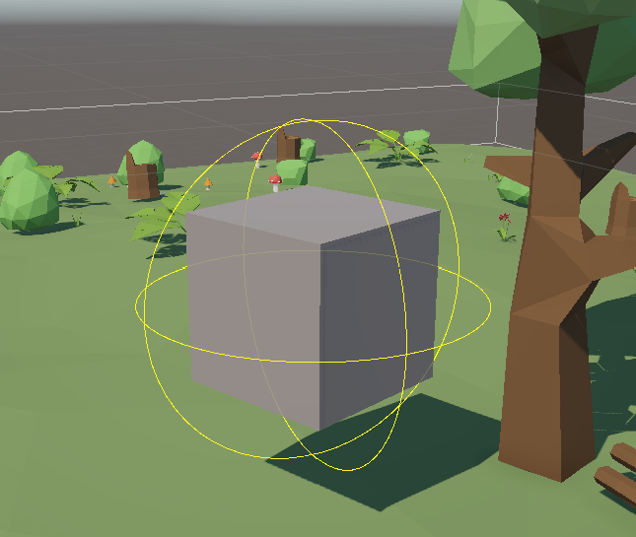
Chapter III - Gizmos
Here are some useful tips to use in unity:
Gizmos with:
OnDrawGizmos()
and
OnDrawGizmosSelected()
As the name says the Selected version only appears when object is selected.

Slide 38
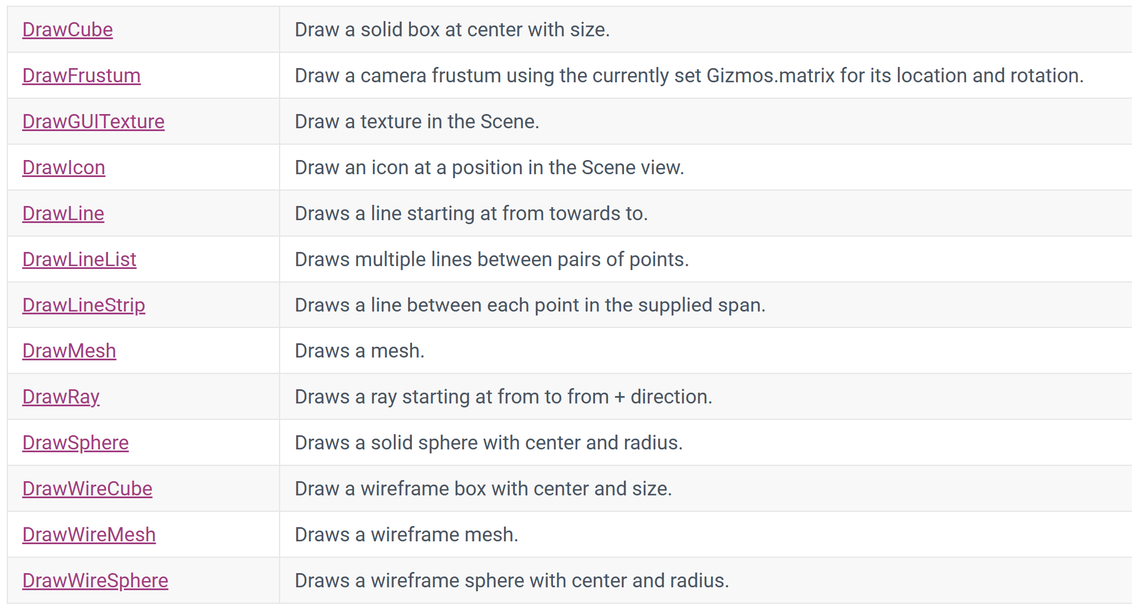
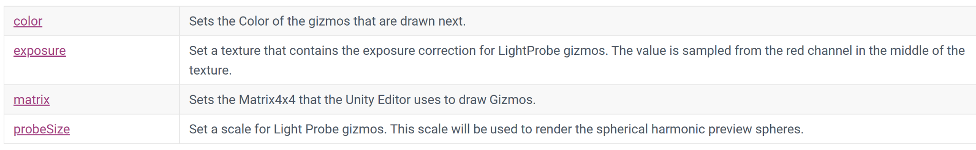
Chapter III - Gizmos
Here are some useful tips to use in unity:
Gizmos allow you to draw:
multiple shapes
and colours
See the documentation:
Unity - Scripting API: Gizmos (unity3d.com)

Slide 39
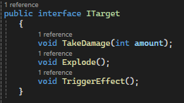
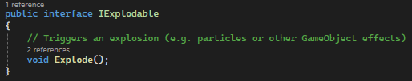
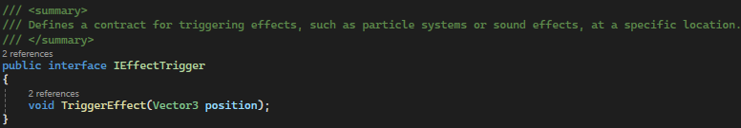
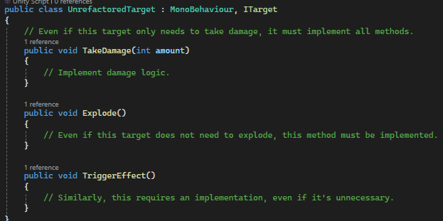
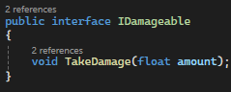
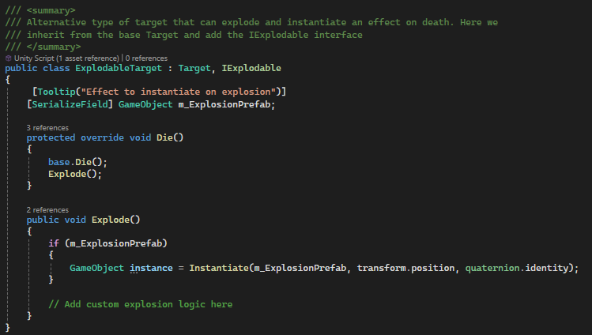
SOLID
Coding best practices
I = Interface segregation Principle
“No client should be forced to depend on methods it does not use."
In other words:
Split large interfaces in smaller, specific ones.

Slide 40
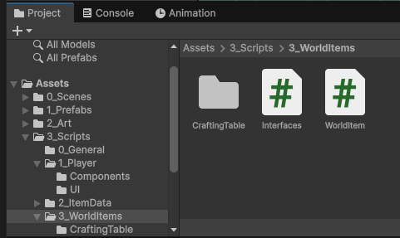
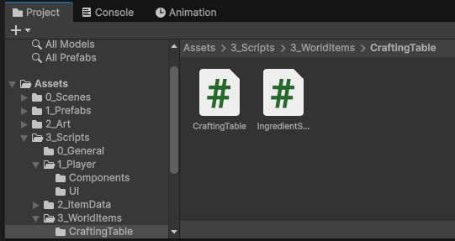
Chapter III - Interfaces
Open:
Assets/3_Scripts/3_WorldItems/World Item
Assets/3_Scripts/3_WorldItems/
CraftingTable & IngredientStation

Slide 41
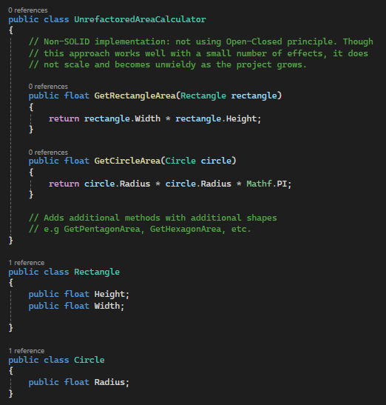
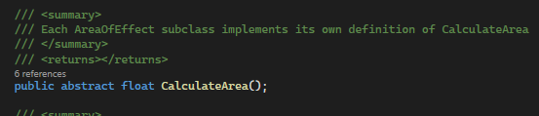
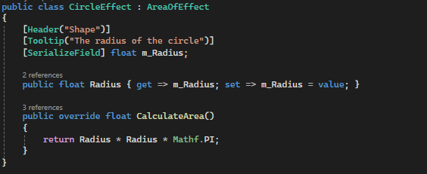
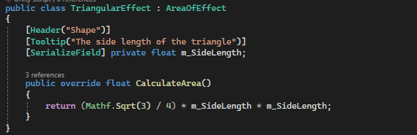
SOLID
Coding best practices
O = Open-Closed Principle
“Software entities should be open for extension but closed for modification."
In other words:
You should create an Interface for general purpose and implement logic in the derived classes.

Slide 42
Chapter IV
Saving Singleton & Observer Pattern

Slide 43
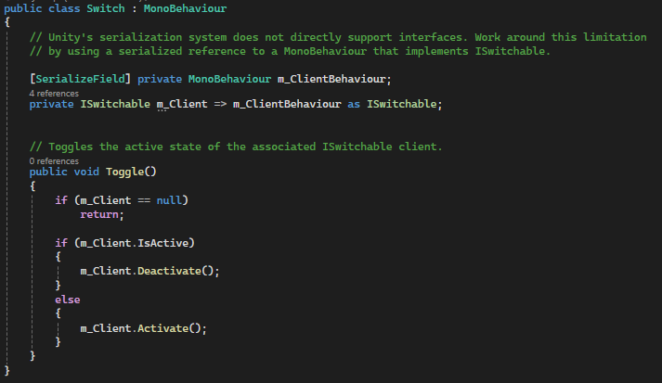
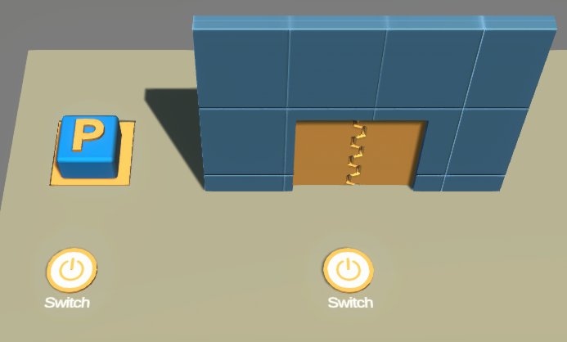
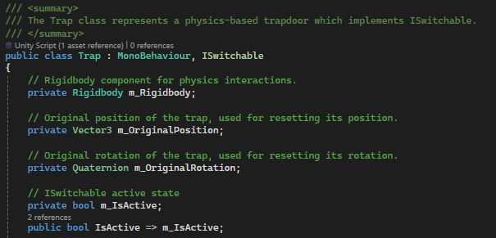
SOLID
Coding best practices
D = Dependency inversion Principle
“Depend upon abstractions, not concretes.”
In other words:
High level modules don’t depend on low level modules. Both depend on abstraction.

Slide 44
SOLID
Coding best practices
High
High
Example : Trap,Door and Switch
Low

Slide 45

SOLID
Coding best practices
Low
In our game we have:
Assets/3_Scripts/4_Saving/IDataService
And
Assets/3_Scripts/4_Saving/JsonDataService
High

Slide 46
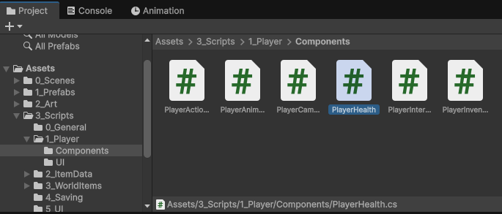
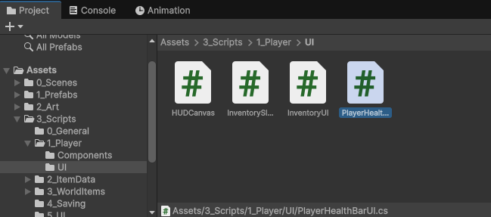
Chapter IV – Observer Pattern
Time to PRACTICE ! Open
PlayerHealth.cs
and
PlayerHealthBarUI.cs

Slide 47
Chapter IV - Singleton
Open
WorldItemManager
and
WorldItem Once done Open GameManager

Slide 48
In conclusion we have looked at:
Attributes
Enums
Heritage
Scriptable Objects
Delegates & Actions
Coroutines
Gizmos
Raycasts
Interfaces
Saving (with JSON)
Singleton pattern
Observer pattern

Slide 49
Some references
Brackeys - YouTube
Learn Unity with simple projects
Mix and Jam - YouTube
Unity inspirational programming
Game Maker's Toolkit – YouTube
Diverse content Unity and others
#addon2023 - YouTube
Game conferences (diverse) GDC - YouTube
Gaming industry conferences
Handmade Hero
Creating a game from nothing using C++ (600+ videos)
CppCon - YouTube
C++ talks Améliorez votre code avec les design patterns et SOLID E-book | Unity
Design patterns & SOLID principles

Slide 50
Thank you for listening and :)
GOOD LUCK

